Slide 1
GLR Automated Test Demo
Abel S YANG

Slide 2
Selenium Test Design
Let's look at some of the frameworks involved in the design, as well as important components.
The model for Page object
Using Excel parameterized data
Log and report
Exception handling
Testing in multiple browsers
Capture screenshots or videos

Slide 3
Cucumber framework
Project
Features
Tag
Scenarios
Business Facing
Support 15
languages
Steps
Regular expression
Step Definitions
Support Code
Automation Library
Your System

Slide 4
Cucumber usage in our project- work process
GlrTestRunner
Feature
StepHook
Step Definition
DB
Automation Library
Generate Report
Page method
Page Element

Slide 5
Automated testing - execution flow
Test code
Report
GIT Repertory
Jenkins Job is running
Remote Server
Remote Server

Slide 6
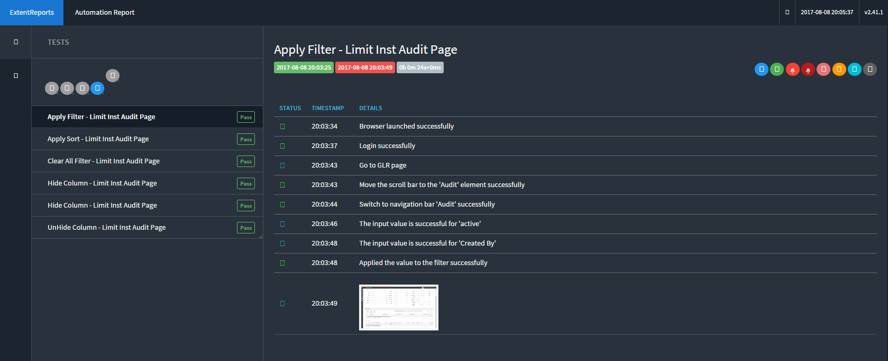
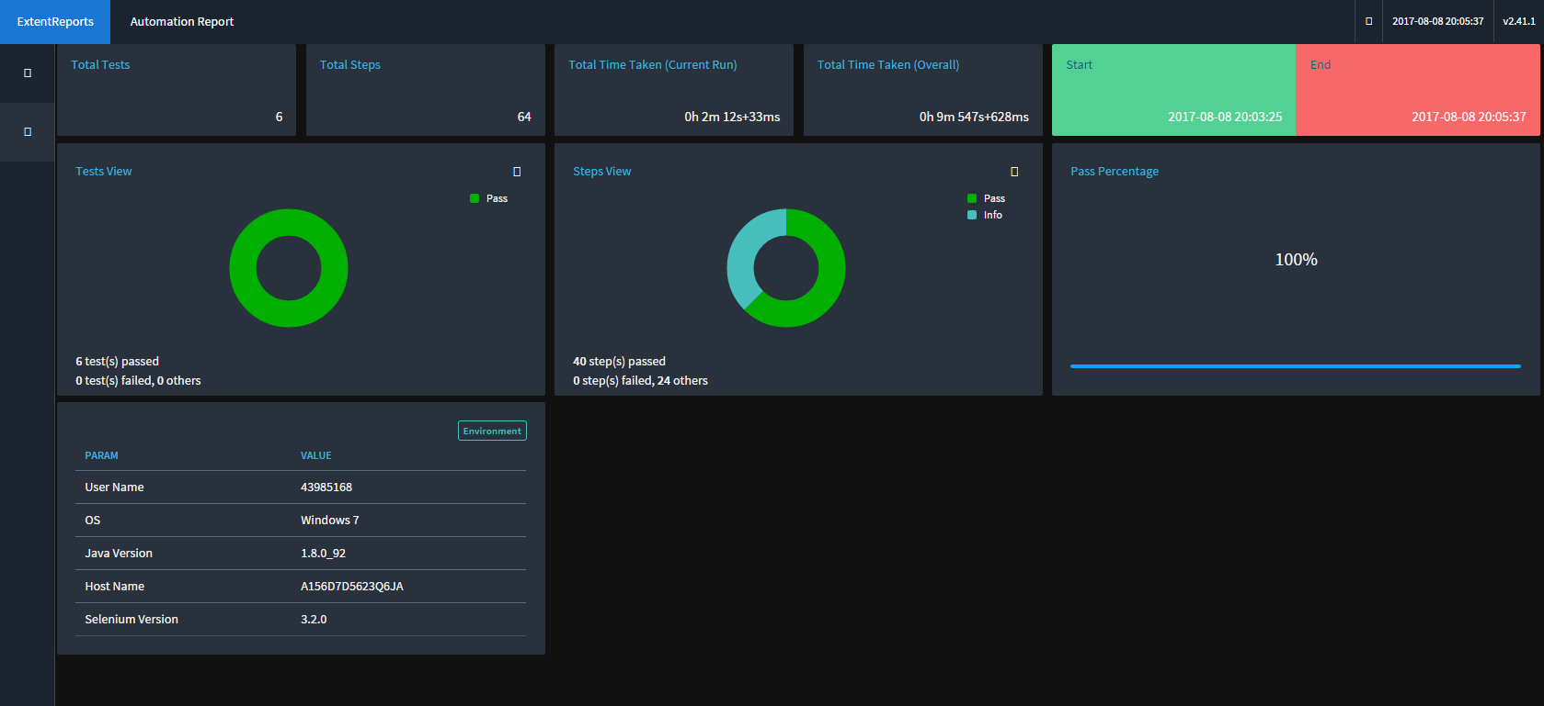
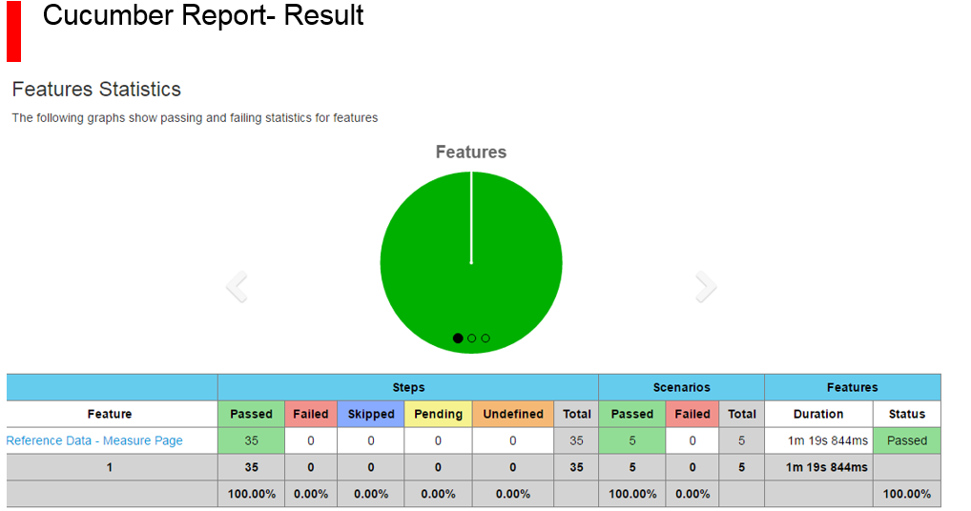
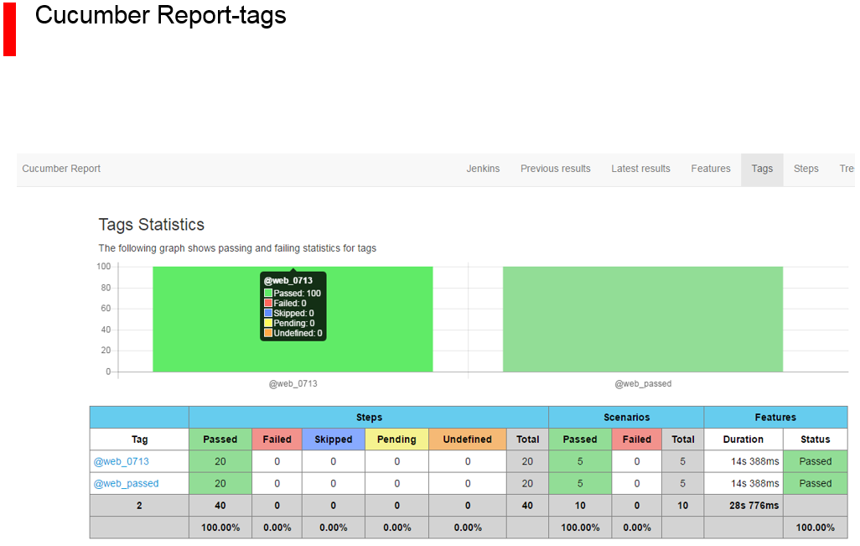
Test report display
Extents Report:
Cucumber Report:

Slide 7
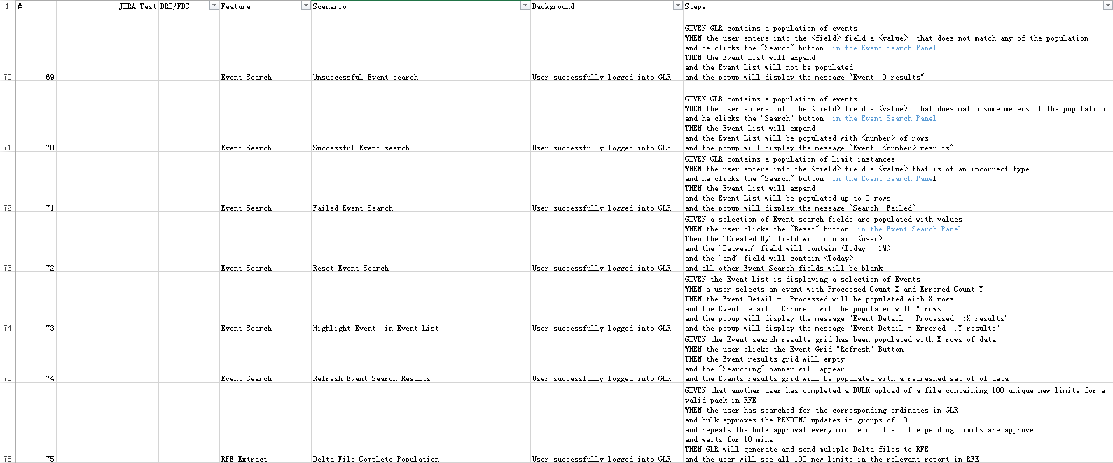
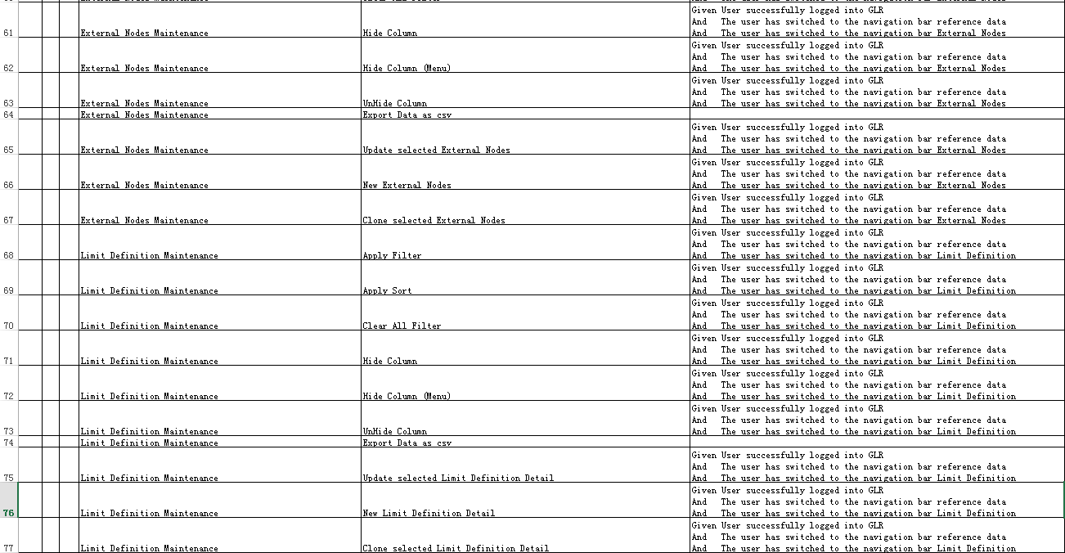
Progress and summary
Before feature
New add feature

Slide 8
Progress and summary

